Slide 1
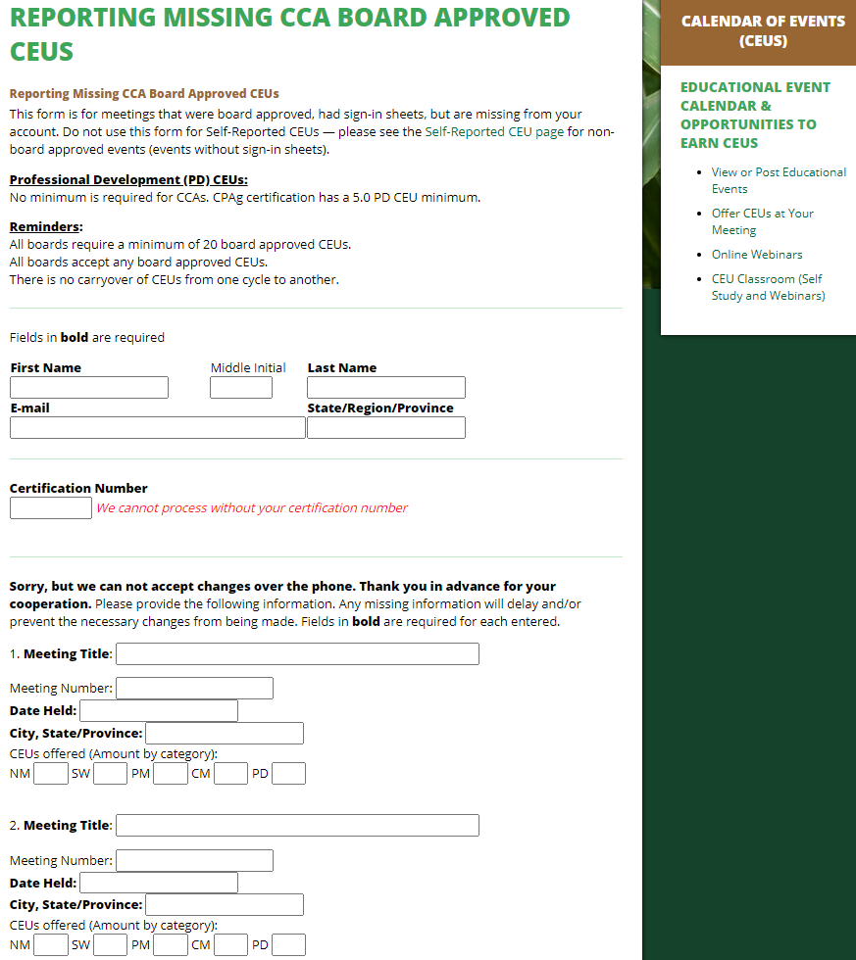
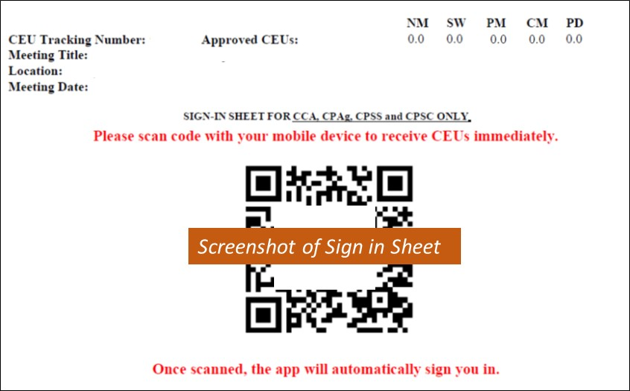
Example template to complete and display at the end of an online training with NR-CCA Board Approved CEUs Title
Date
Time
www.certifiedcropadviser.org/continuing-education/missing-ceus
The app is the preferred mode of signing in!
In the event app isn’t working and there is not a way to sign-in you can report the meeting using this webpage.
Questions on CCA credits contact: Organizer’s Name, Organizer’s email

